Slide 1

Global Academy of Technology
Department of Information Science & Engineering
A Machine Learning Model for
Stock Market Prediction
By,
S.Sangeetha 1GA16IS047 T.Akhila 1GA16IS057

Slide 2
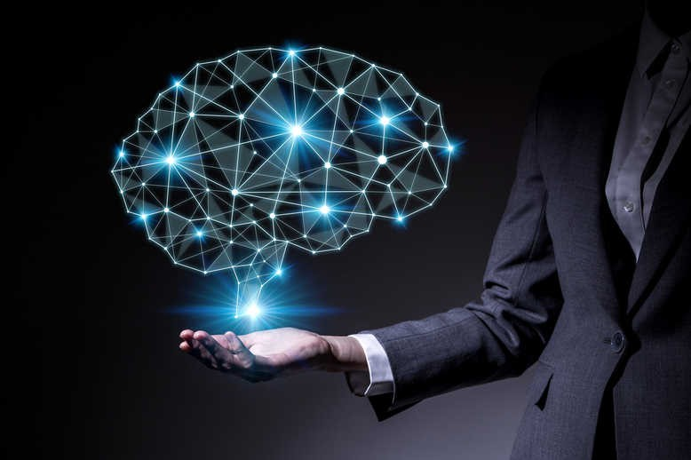
Index
Abstract
Introduction
Objective
Stock exchanges in India
BSE
NSE
Neural networks
Recurrent neural networks
LSTM
Results
Conclusion
References

Slide 3
Stock market prediction is the act of trying to determine the future value of a company stock or other financial instrument traded on a financial exchange.
The successful prediction of a stock's future price will maximize investor’s gains.
A neural networks based model have been used in predicting of the stock market.
Machine learning algorithms will work together and process complex data inputs. A machine learning model to predict Future stock market price of “Apple”.
We use LSTM technique and neural networks to predict the future stock market price of “Apple company”.
ABSTRACT

Slide 4
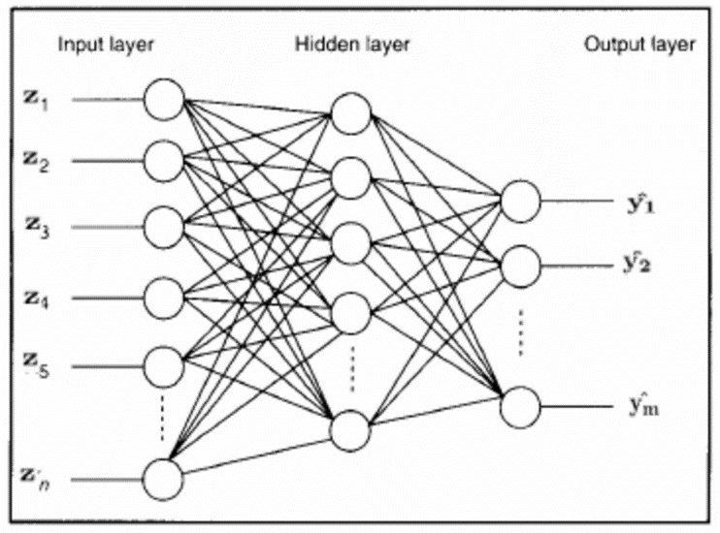
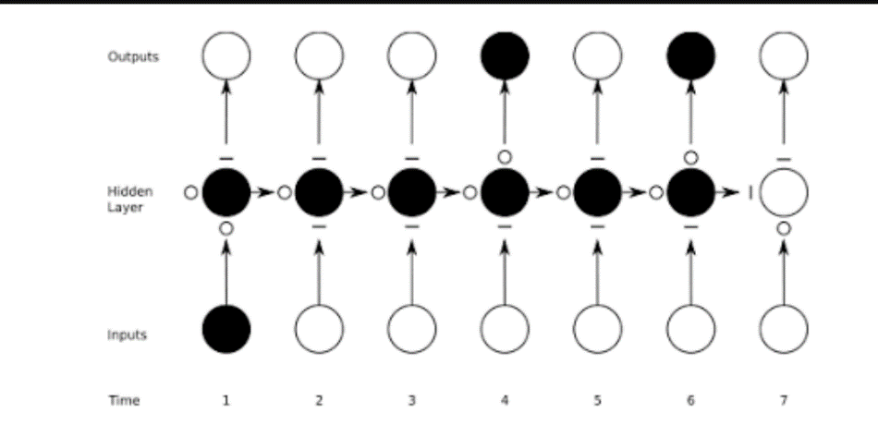
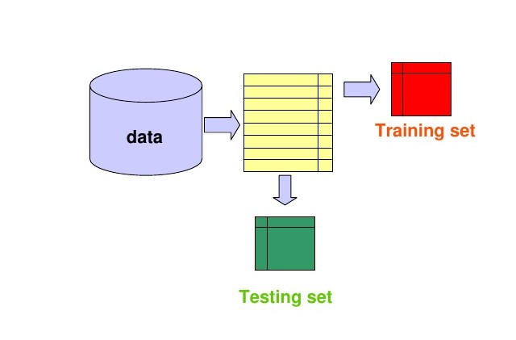
INTRODUCTION
Data pre-processing is a technique that is used to convert the raw data into a clean data set. In other words, whenever the data is collected from different sources it is in the raw format which is not feasible for the analysis. By using this technique transform the raw data into an understanding format. Real world data is often incomplete, inconsistent and having many errors.
LSTM(LONG SHORT-TERM MEMORY) is an artificial recurrent neural network(RNN) architecture.LSTM networks are well suited to classifying, processing and making predictions based on time series data, since there can be lags of unknown duration between important events in the time series.
Artificial neural networks(ANN) are computing systems inspired by biological neural networks that constitute animal brains. The neural network itself is not an algorithm, but rather an framework for many machine learning algorithms to work together and process complex data inputs.

Slide 5

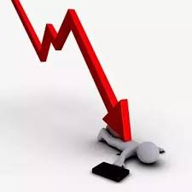
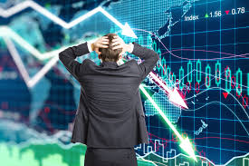
OBJECTIVE
The main objective to reduce the investment cost unnecessarily.
In those days, people used to invest money of the product and the outcome may not be as expected. So this leads to major drop in the company, whole share will drop down.
To overcome this, we predict the future stock market price and then invest accordingly ,which reduces the cost, time and more over enhances the growth of the company.

Slide 6
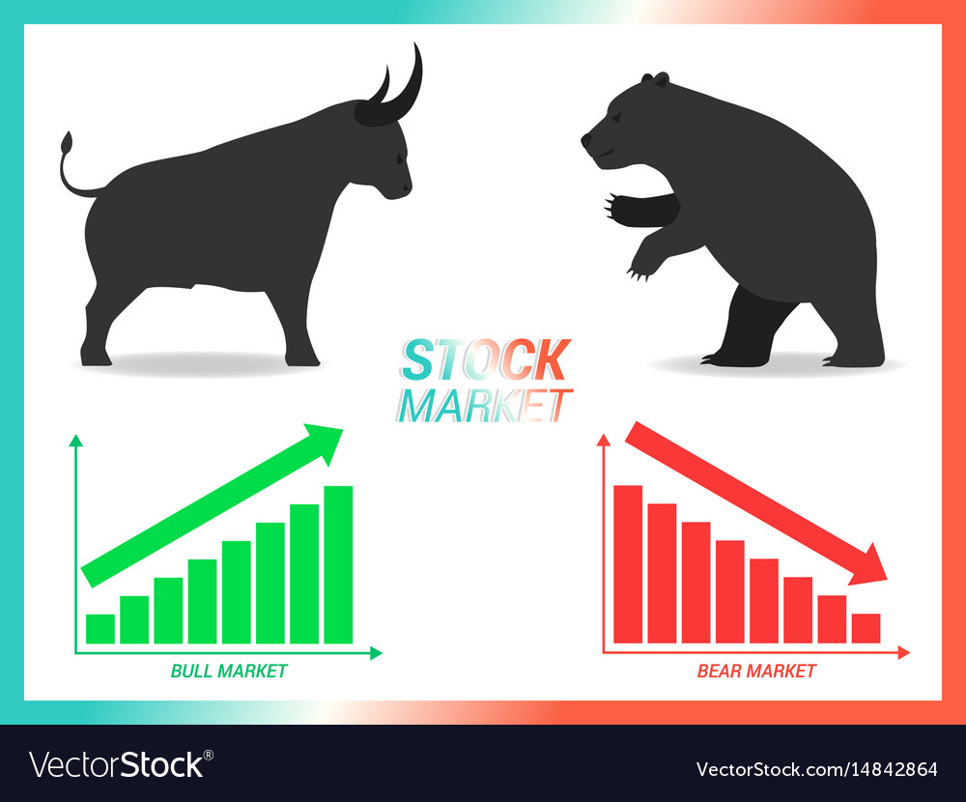
STOCK EXCHANGES IN INDIA
There are 22 stock exchanges in India.But two of them are biggest.
BSE(BOMBAY STOCK EXCHANGE)-The asia’s first stock exchange and world’s tenth largest stock exchange
NSE(NATIONAL STOCK EXCHANGE)- The first exchange in
the country to provide modern fully automated screen based
electronic trading system.
.

Slide 7
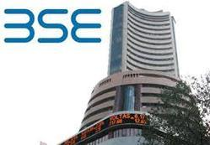
BOMBAY STOCK EXCHANGE
Location :Mumbai
Index :Sensex(SENSITIVE INDEX)
Group of 30 stocks
Members :852
Date of launch :03 jan 1986
No of listings :5439
Market cap :Rs1,50,184 billion

Slide 8
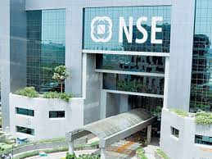
NATIONAL STOCK EXCHANGE
Location :Mumbai
Index :Nifty(NATIONAL STOCK EXCHANGE FIFTY)
Consists of group of 50 stocks
Date of launch :April 1994
No of Listings :2000

Slide 9
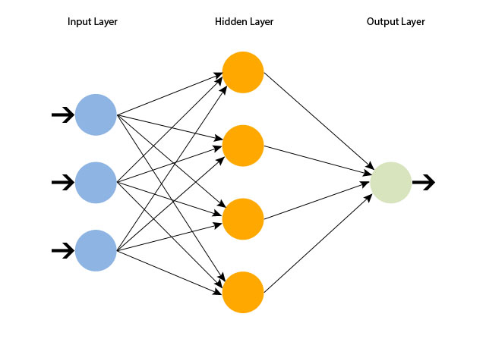
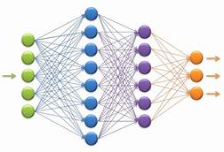
Artificial neural networks (ANN)
Artificial neural networks (ANN) or connectionist systems are computing systems inspired by the biological neural networks that constitute animal brains.
The neural network itself is not an algorithm, but rather a framework for many different machine learning algorithms to work together and process complex data inputs. Such systems "learn" to perform tasks by considering examples, generally without being programmed with any task-specific rules.
For example, in image recognition, they might learn to identify images that contain cats by analyzing example images that have been manually labeled as "cat" or "no cat" and using the results to identify cats in other images.
ADVANTAGES:-
Adaptive learning
Self-organization
Real time operating

Slide 10


Recurrent neural networks
A recurrent neural network (RNN) is a class of artificial neural network where connections between nodes form a directed graph along a temporal sequence. This allows it to exhibit temporal dynamic behavior.
Limitations of RNNs:-
Recurrent Neural Networks work just fine when we are dealing with short-term dependencies. That is when applied to problems like:
RNNs turn out to be quite effective. This is because this problem has nothing to do with the context of the statement. The RNN need not remember what was said before this, or what was its meaning, all they need to know is that in most cases the sky is blue. Thus the prediction would be:
Something that was said long before, cannot be recalled when making predictions in the present. The reason behind this is the problem of Vanishing Gradient. RNN remembers things for just small durations of time, i.e. if we need the information after a small time it may be reproducible, but once a lot of words are fed in, this information gets lost somewhere. This issue can be resolved by applying a slightly tweaked version of RNNs – the Long Short-Term Memory Networks.

Slide 11
LONG SHORT-TERM MEMORY
Long Short-Term memory is one of the most successful RNNs architectures.
LSTM introduces the memory cell, a unit of computation that replaces traditional artificial neurons in the hidden layer of the network. With these memory cells, networks are able to effectively associate memories and input remote in time, hence suit to grasp the structure of data dynamically over time with high prediction capacity.
Methodology of LSTM:-
Stage 1:
Raw Data: In this stage, the historical stock data is collected from the Google stock price and this historical data is used for the prediction of future stock prices.

Slide 12
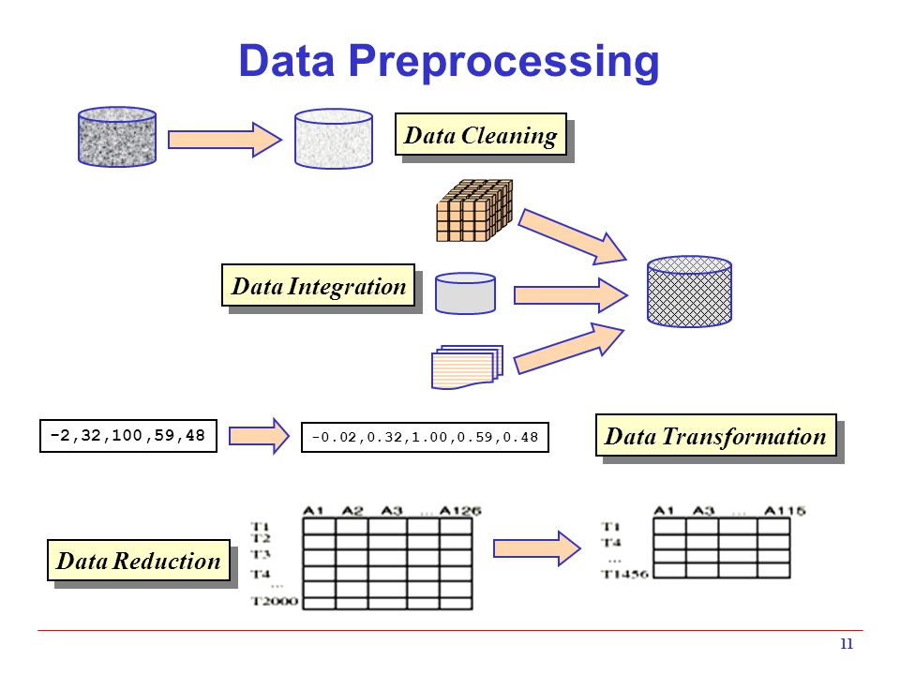
Stage 2: Data Preprocessing: The pre-processing stage involves
Data discretization: Part of data reduction but with particular importance, especially for numerical data
Data transformation: Normalization.
Data cleaning: Fill in missing values.
Data integration: Integration of data files. After the dataset is transformed into a clean dataset, the dataset is divided into training and testing sets so as to evaluate.

Slide 13
Stage 3:
Feature Extraction: In this layer, only the features which are to be fed to the neural network are chosen.
Stage 4:
After pre-processing is done, we spilt the dataset in to trainset and test set using “minmaxscaler”.
Minmaxscaler goes like this:-
Minmaxscaler is probably the most famous scaling algorithm and follows the following formula:-
(xi–min(x))/(max(x)–min(x))
It essentially shrinks the range such that the range is now between 0 and 1 (or -1 to 1 if there are negative values).
It essentially shrinks the range such that the range is now between 0 and 1 (or -1 to 1 if there are negative values).This scaler works better for cases in which the standard scaler might not work so well. If the distribution is not Gaussian or the standard deviation is very small, the min-max scaler works better.
Existing system:-was manual

Slide 14
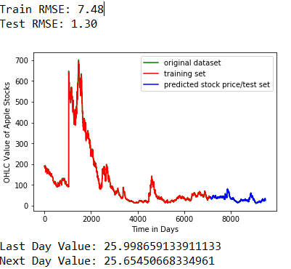
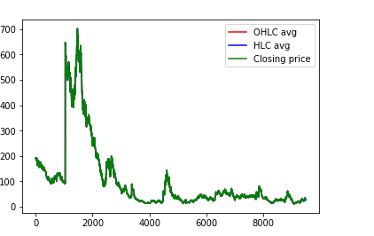
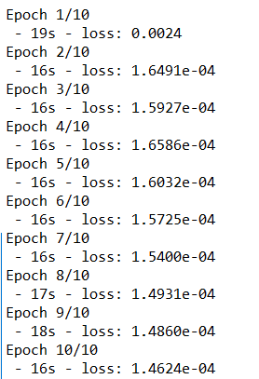
RESULT

Slide 15

Conclusion
By doing data pre-processing we can convert raw data into clean, understandable data and standardized data.
It will help for share Holders to predict the future.
Two of the most widely used methods, Fundamental Analysis and Technical Analysis showed little promise in the experiments carried out.
We can conclude that using this proposed method and technique we can easily and accurately predict the future price of the market.

Slide 16


REFERENCES
[1] https://scikit-learn.org/stable/modules/generated/sklearn.preprocessing.MinMaxScaler.html
[2] https://scikit-learn.org/stable/index.html
[3]https://www.doc.ic.ac.uk/~nd/surprise_96/journal/vol4/cs11/report.html#What%20is%20a%20Neural%20Network
[4]https://www.google.com/search?q=data+preprocessing&rlz=1C1GIGM_enIN805IN805&source=lnms&tbm=isch&sa=X&ved=0ahUKEwjAo5ji7tngAhVMRo8KHfCLBPIQ_AUIDigB&biw=1366&bih=65

Slide 17


